Slide 1


Smart Parking Management System Using WSN and IoT
Subject: Wireless Sensor Network
Submitted By:
Siddharth Linga | A04325980 | W02
Chandrahaas Reddy Guntaka | A04328583 | W01
Venkata Hitesh Kumar Akunuri | A04318425 | W01
Sathya Sai Tarun Matta | A04324592 | W02

Slide 2
Smart Parking Management System Using WSN and IoT
Welcome to the future of urban parking solutions.
Our Smart Parking Management System leverages the power of Wireless Sensor Networks (WSN) and Internet of Things (IoT) to address the growing challenges of parking in modern cities.
This innovative system promises to revolutionize how we approach urban parking, offering real-time updates, differentiated services, and a seamless user experience.

Slide 3

The Growing Challenge of Urban Parking
—
—
Urban Traffic
Time Wasted
Caused by parking searches
Average search time
—
—
Fuel Wasted
CO2 Emissions
Per search on average
Per parking search
Urban parking has become a significant challenge in our growing cities. The constant search for parking spaces leads to increased traffic congestion, wasted time and fuel, and higher emissions. These issues not only affect individual drivers but also contribute to broader urban problems like air pollution and reduced quality of life.

Slide 4
Why Current Solutions Fall Short
RFID-Based Systems
Camera-Based Systems
IoT Sensor-Based Systems
While effective for access control, these systems lack real-time occupancy monitoring and can be expensive to implement on a large scale.
Offer visual monitoring but face challenges with accuracy in varying light conditions and have high installation and maintenance costs.
Provide real-time data but often lack integration with wider city systems and face battery life limitations.

Slide 5

Building the System
Hardware
Software
Cloud Infrastructure
Ultrasonic/infrared sensors for occupancy detection
Backend: Flask/Django for server-side logic
AWS IoT Core for device management and data ingestion
Raspberry Pi microcontrollers for data processing
Frontend: React Native for cross-platform mobile app
AWS Lambda for serverless computing
Low-power WSN nodes for communication
Machine learning algorithms for predictive analytics
Amazon S3 for data storage and analytics

Slide 6
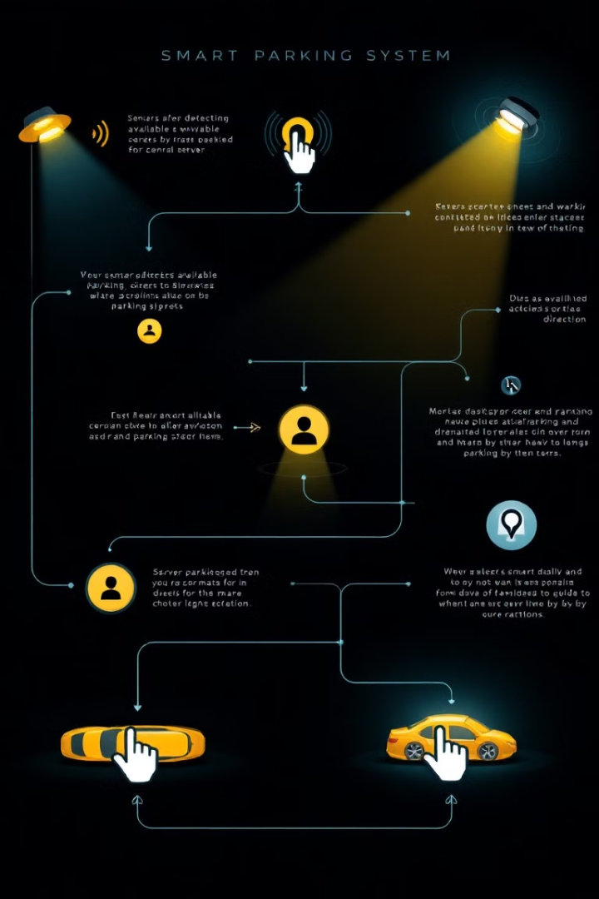




The Smart Parking Management System
WSN-enabled IoT Sensors
Deploy energy-efficient sensors for real-time occupancy detection
Cloud Integration
Process and store data for scalable operations and analytics
Mobile App Interface
Provide users with real-time updates and booking capabilities
VIP and Normal Zones
Offer differentiated services to cater to various user needs

Slide 7




How the System Works
Mobile App
1
User interface for parking management
Cloud Server
2
Data processing and storage
WSN Nodes
3
Communication network
IoT Sensors
4
Occupancy detection in parking spots
Our system architecture is designed for efficiency and scalability. IoT sensors detect vehicle presence in each parking spot. These sensors communicate through a Wireless Sensor Network to relay data to the cloud server. The cloud processes this information and sends real-time updates to users through a mobile app, creating a seamless parking experience.

Slide 8
Key Outcomes and Metrics
Feature | RFID based system | Camera based system | Proposed system
Real-time | No | Yes | Yes
Scalability | Medium | High | High
Cost efficiency | High | Low | High
Energy efficiency | Medium | Low | High
User differentiation | No | No | Yes
Our system has demonstrated remarkable success, with an 95% successful parking rate.
The remaining 5% of failed attempts are primarily due to capacity limitations during peak hours.
Revenue analysis shows a healthy mix, with VIP zones contributing 20% of the total $400 average daily revenue.
Additionally, our energy-efficient WSN protocols have resulted in a 30% reduction in power consumption compared to traditional systems.

Slide 9
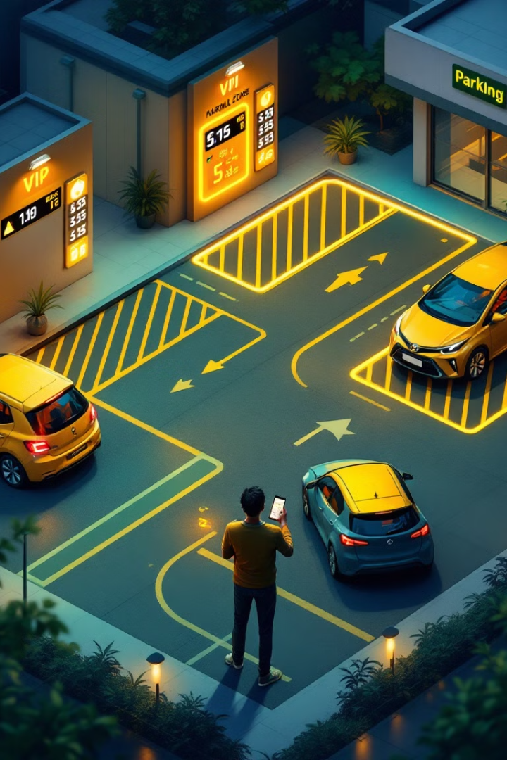




What Makes It Smart?
Differentiated Zones
Dynamic Pricing
VIP and normal parking areas to cater to different user needs
Flat rate for VIP, tiered pricing with penalties for normal zones
Energy Efficiency
Real-time Updates
Optimized WSN protocols to extend battery life of sensors
Mobile app provides instant information on parking availability

Slide 10
Expanding the Vision
1
Dynamic Pricing
Implement demand-based pricing to optimize occupancy and revenue
2
Reservation System
Allow users to book parking spots in advance for guaranteed availability
3
Smart City Integration
Connect with traffic management systems for comprehensive urban mobility solutions
4
AI-Powered Predictions
Utilize machine learning for accurate parking availability forecasts
5
Sustainable Power
Integrate solar-powered sensors for eco-friendly operations

Slide 11

A Smarter Way to Park
Real-time Parking Updates
Improved Efficiency
Scalable and Sustainable
Eliminate the frustration of searching for parking spots with instant availability information
Reduce traffic congestion and emissions while saving time and fuel for drivers
Future-proof design that can adapt to growing urban needs and environmental concerns
Our Smart Parking Management System is poised to transform urban mobility. By leveraging WSN and IoT technologies, we're not just solving today's parking challenges – we're paving the way for smarter, more efficient cities of tomorrow. Join us in revolutionizing urban parking and building a more sustainable future for our cities.

